Slide 1
WELCOME

Slide 2


PDM University Website
Development And Management
By : Mahaboob Alam

Slide 3

Contents –
PDM University Website Development & Management
Abstract
Introduction
Page Details
Conclusion

Slide 4
Content - for PDM University Website Development & Management
01
ABSTRACT
This projects is basically on the university management system. In this project I want to show how a university information can be managed with less effort.
This website is made using HTML, CSS, JavaScript, Bootstrap, CorelDraw, PHP and Database managed by MySQL.
In this website I have taken various pages and each page correspond to a specific type of info.

Slide 5
Content - for PDM University Website Development & Management
02
INTRODUCTION
The purpose of this website is that every information ,Updating could be made available to the Students and Faculties online.
Through the website it can be accessed by the people globally.
There are many features which helps students and faculties to keep records of available information.

Slide 6
Content - for PDM University Website Development & Management
03
PAGE DETAILS
This website consists 10 pages in which some are external and some are internally shown.
Some of the pages are as follows –
▶ Home
▶ About
▶ Course
▶ Blog
▶ Contact
▶ Login / SignUp

Slide 7
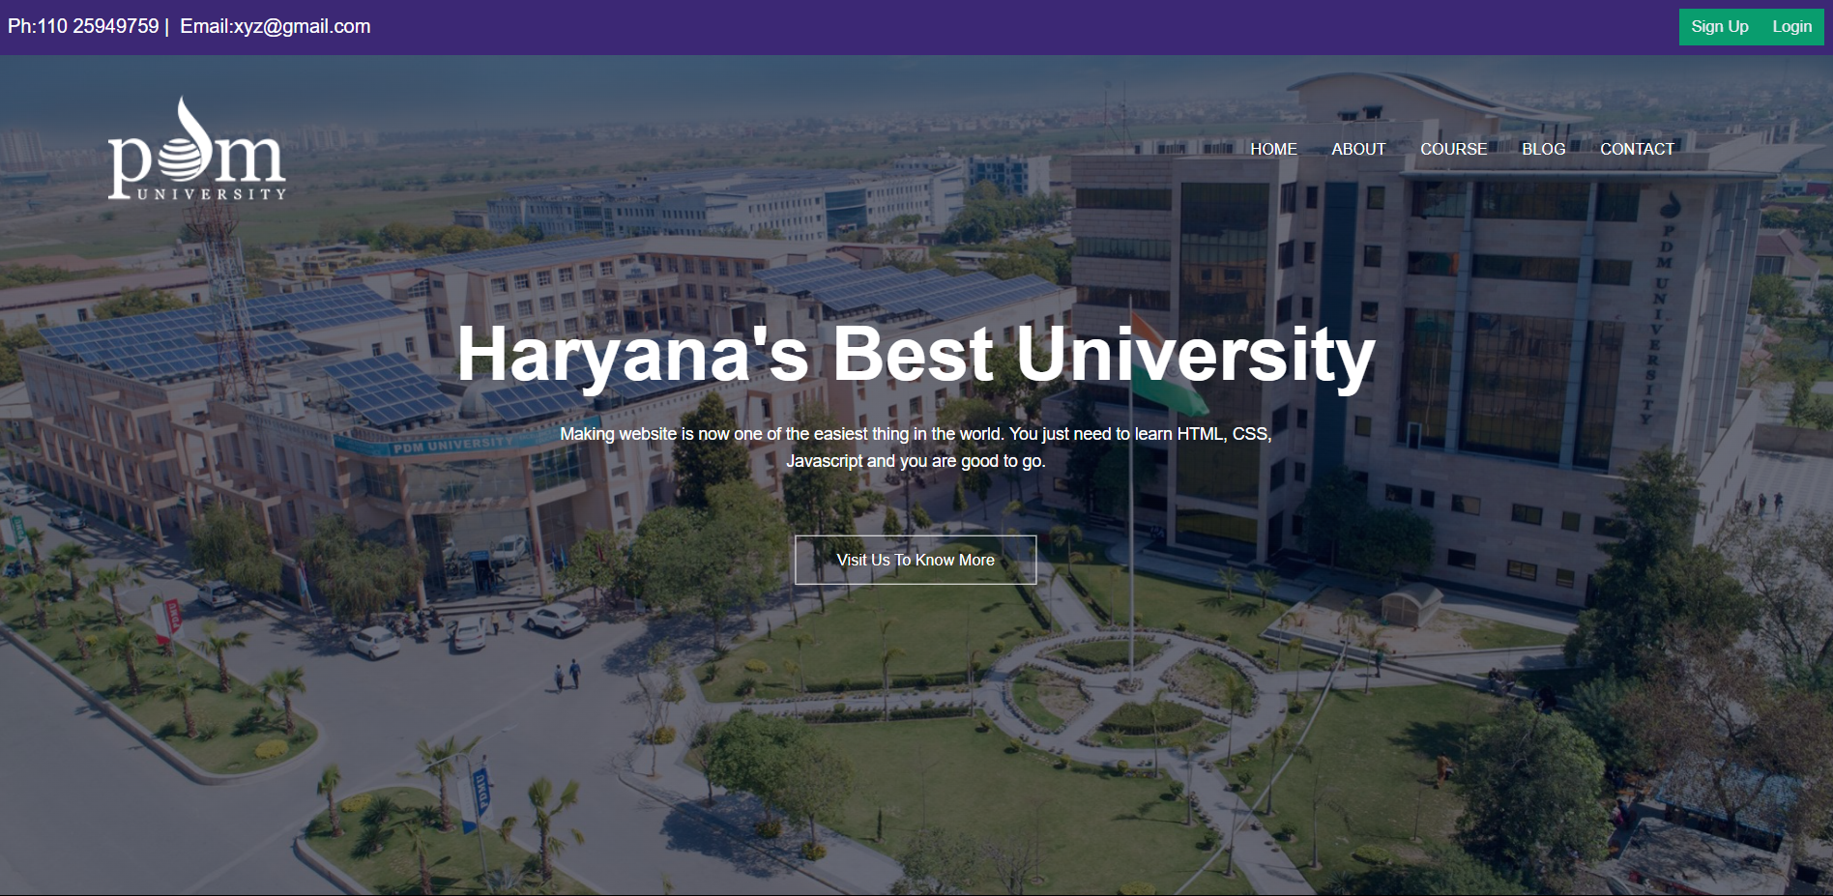
Home

Slide 8
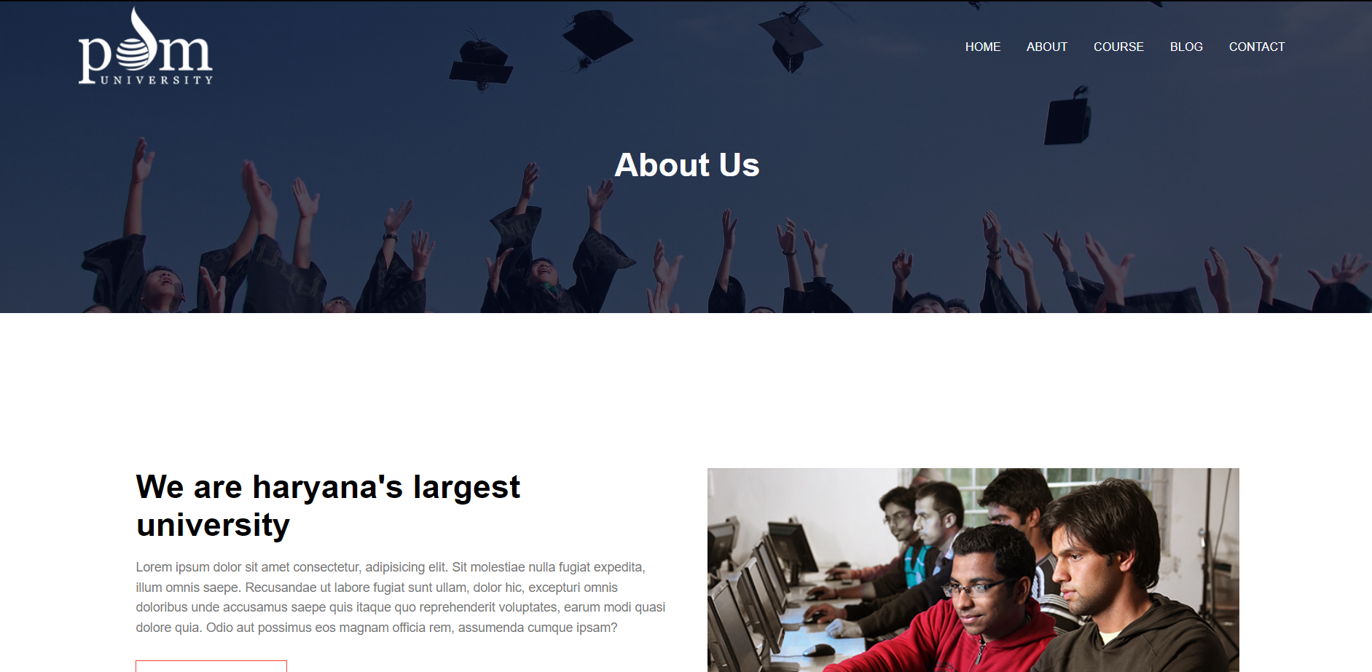
About

Slide 9

Course

Slide 10
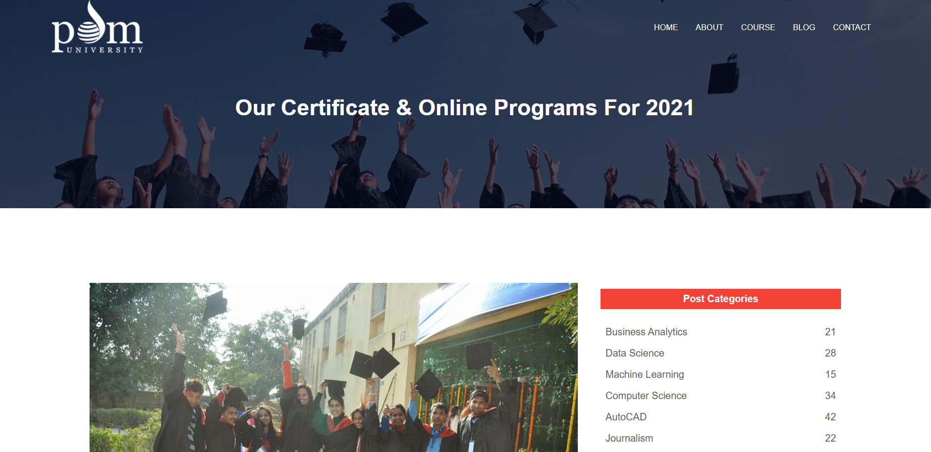
Blog

Slide 11
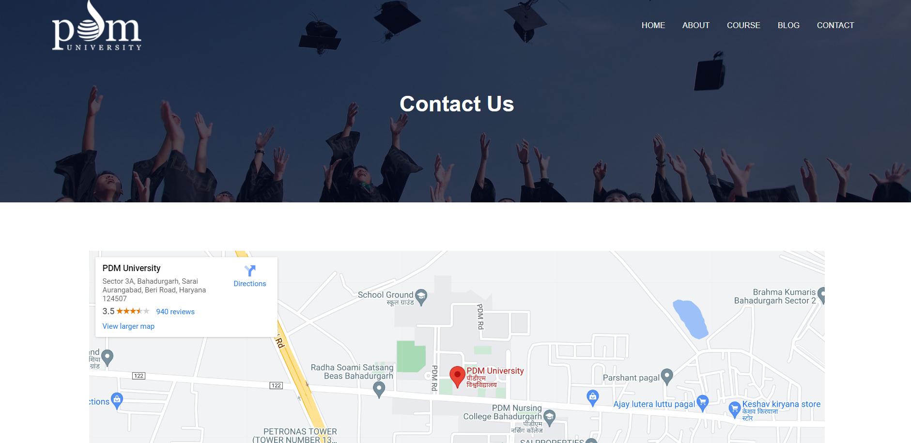
Contact

Slide 12
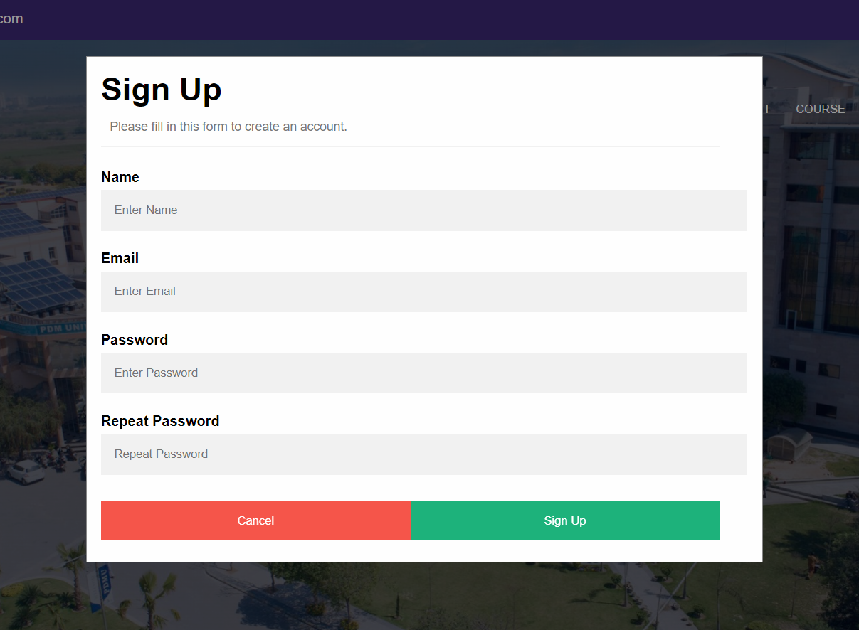
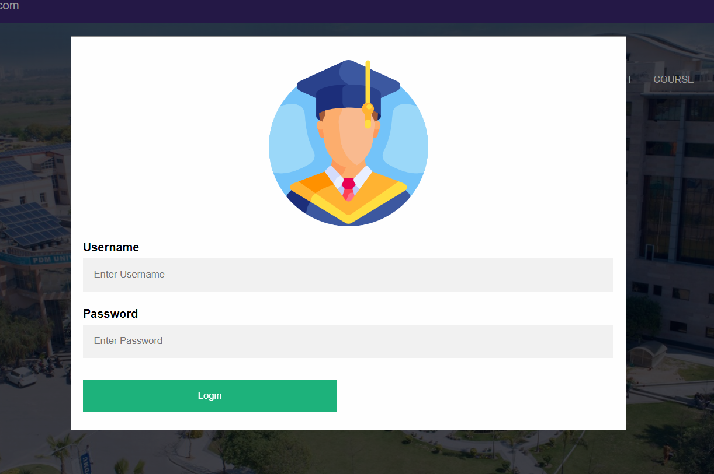
Login / Sign Up
Sign Up – Page Login - Page

Slide 13
Flowchart of Login & Sign Up in PDM University Development and Management
This chart providing information regarding the Login and Sign Up
Start
Enter to the website
Have an account
NO
Sing up
Fill out the information
YES
Login
Submit
NO
Enter e-mail and password
E-mail and password valid
Loged into the system
End

Slide 14
Content - for PDM University Website Development & Management
04
CONCLUSION
Our purposed system has made the whole process computerized which is more easy and efficient to operate.
The system enhances the accessibility of the university management in terms of quality ,range and services.
The computerized system make user to explore the university related information and easy to store data and retrieve data. It is more perfect and accessible than manual management system

Slide 15




Thank You
Address
Ahemdabad ,Gujarat
Contact
+91 8081153119
Email
amahboob251@gmail.com

